Slide 1
Correlation Techniques -
Covariance,
Pearson Correlation coefficient
Spearman rank correlation coefficient

Slide 2
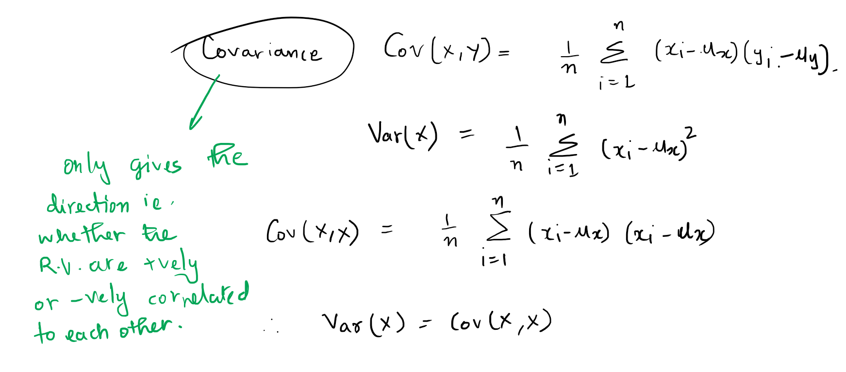








Slide 3













Slide 4











Slide 5
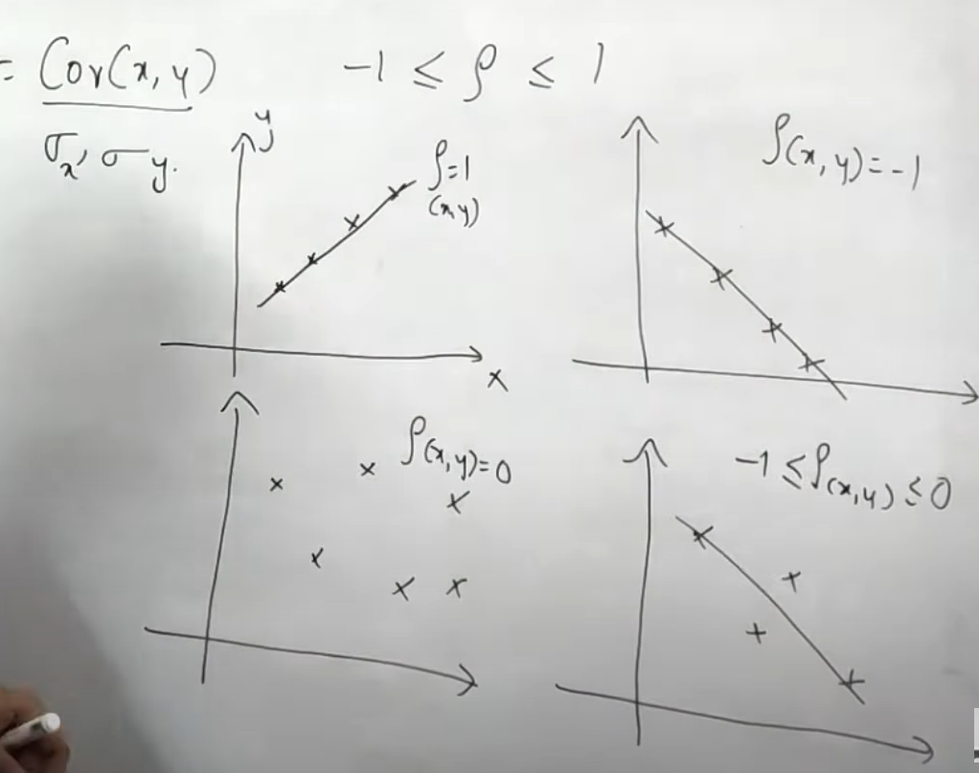



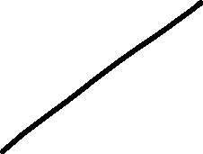

Slide 6
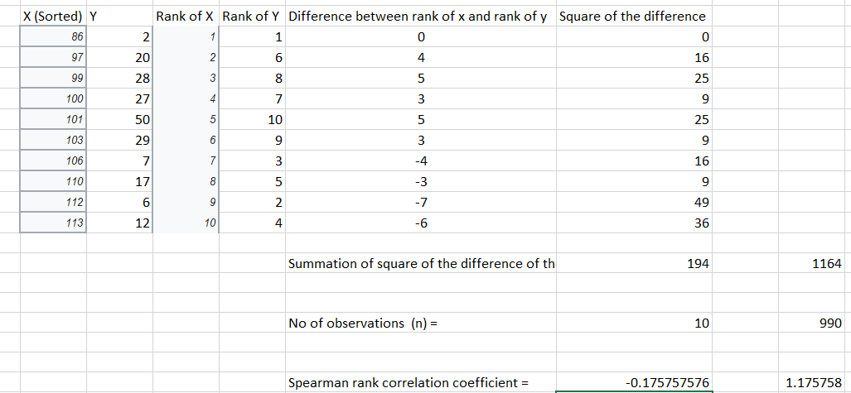


















https://en.wikipedia.org/wiki/Spearman%27s_rank_correlation_coefficient

Slide 7












Slide 8






























